Slide 1

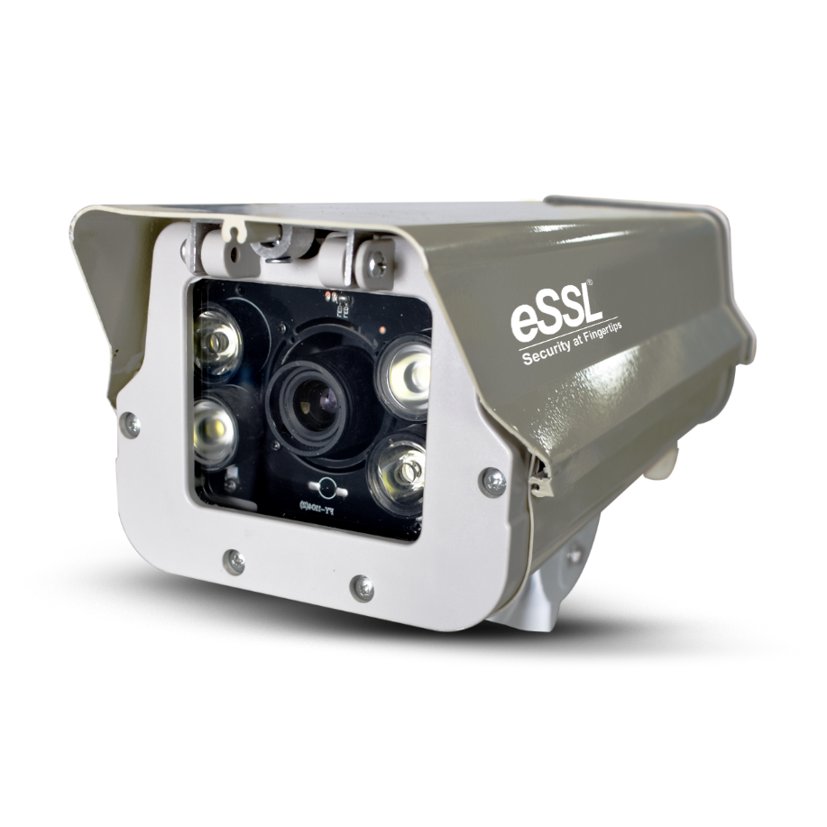
LPR CAMERA

Slide 2
DEFINITION
LPR (License Plate Recognition) is a technology that uses specialized cameras and software to automatically capture and read vehicle license plates. It works by using Optical Character Recognition (OCR) combined with image processing algorithms to identify and record the alphanumeric characters on a license plate, enabling automated tasks like parking management and security surveillance.

Slide 3
APPLICATIONS OF LPR CAMERAS
Parking Management: Automates the entry/exit process, tracks occupancy, and enforces parking rules.
Security and Surveillance: Identifies vehicles entering restricted areas and checks them against databases for blacklisted Vehicles.
Access Control: Allows authorized vehicles to enter or exit a facility without human intervention.

Slide 4
IMPORTANCE OF PARKING MANAGEMENT
Benefits of LPR in Parking:
Improved efficiency and automation.
Enhancing Safety and Security.
Maximizing Space Utilization.
Reducing Traffic Congestion.
Improving Customer Satisfaction
Current Issues:
Lack of real-time monitoring.
Security concerns and unauthorized access.
Inefficient parking space utilization.

Slide 5
HOW LPR CAMERA WORKS?
The LPR camera is strategically positioned at the entrance/exit of a parking lot, road, or other monitored areas. It captures high-resolution images of passing vehicles.
Capture Image: The camera takes a high-resolution photo of the vehicle’s license plate.
Detect Vehicle: The camera detects when a vehicle enters the view using sensors or motion detection.
Locate License Plate: The camera’s software identifies where the license plate is located within the image.
Read Characters: The software uses Optical Character Recognition (OCR) to read the letters and numbers on the plate.
Process Data: The plate number is processed and can be compared to databases (like allowed or blacklisted vehicles).
Trigger Action: Based on the result (authorized or not), it may open a gate, send an alert, or log the vehicle’s data.
Store Information: The plate number, along with time and location, is stored for future reference or reporting.

Slide 6
KEY FEATURES
Real-Time Monitoring: Automatic entry/exit logging.
Access Control: Only authorized vehicles can enter designated areas.
High-Speed Recognition: LPR cameras can recognize license plates at high speeds, even in fast-moving traffic.
Automatic Capture: The camera automatically captures images of the license plate as a vehicle enters/exits an area.
Day and Night Operation: LPR cameras can work in various lighting conditions, including low light or at night, using infrared technology or high-definition optics.
Real-Time Data Processing: The captured plate data is processed in real-time and can be linked to a database for verification, authorization, or security monitoring.

Slide 7
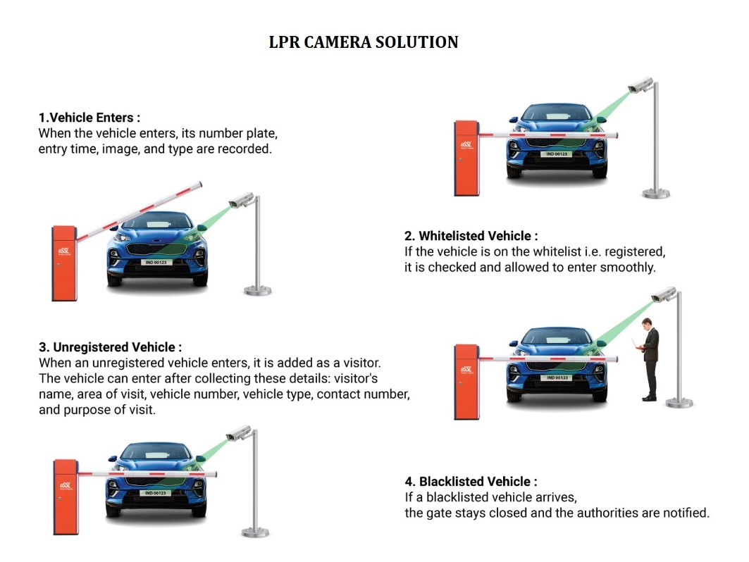

Slide 8
Contact Us
Head Office:
#24 Shambavi Building 23rd Main Marenahalli
JP Nagar 2nd Phase Bengaluru - 560078
For Sales :
sales@esslsecurity.com
8884406789 (Only Whatsapp)
For Technical Support :
+918046159990 , +918026090500
support@esslsecurity.com

